Slide 1
MCCP6020 Advanced English for Academic Purposes
Session 1
Course Introduction
Overview of Thesis and Journal Article Writing

Slide 2
Your Lecturer
Dr. XXXXX
Email: XXXXXXXXXXXXXXX
Office Tel: XXXXXXXXXXXXXXXXXX
Office: XXXXXXXXXXXXXXXXXXXXXXXXXXXXXXX

Slide 3
Learning Outcomes:
By the end of this session, students should be able to:
recognize the course structure, rationale and assessments
identify various thesis and journal article structures
identify the functions, rhetorical moves, key components and the linguistic features of an effective introduction of a thesis/journal article in their own disciplines
write a centrality statement to highlight the significance of their research within their fields
deploy appropriate linguistic features and rhetorical moves to write an introduction for their own research; and
introduce their research to a non-specialist audience verbally

Slide 4
Introduction to the Course
CILO | By the end of the course, students should be able to:
CILO 1 | Understand and apply the appropriate structure and format of academic presentations and critically evaluate their own and their peers’ presentations.
CILO 2 | Recognize the generic features of PhD thesis and research journal articles and apply the acquired structures or move development in their own writing.
CILO 3 | Identify and build a repertoire of linguistic features for both academic speech and writing, including signposts, cohesive devices, and grammatical patterns, etc. for both academic presentations and writing.
CILO 4 | Acknowledge and document a wide range of sources strategically and systematically in the form of in-text citations, footnotes, endnotes, bibliographies, and references.
Course Intended Learning Outcomes:

Slide 5
Introduction to the Course
Course content
The course focuses on academic presentations and research writing:
Citing sources accurately and compiling the bibliography or references
Analyzing the format and structure of academic presentations
Planning and organizing a short academic presentation
Analyzing the frameworks for thesis writing and research articles
Analyzing and comparing linguistic features of academic speech and writing
Comparing the stylistic features of academic speech and writing
Effective communication in both academic speech and writing
Considering assessment criteria and proofreading the thesis

Slide 6
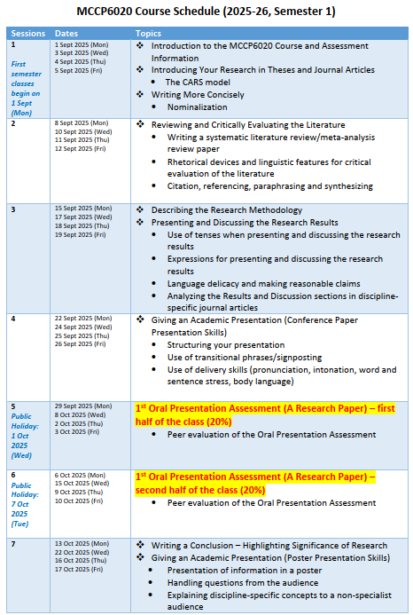
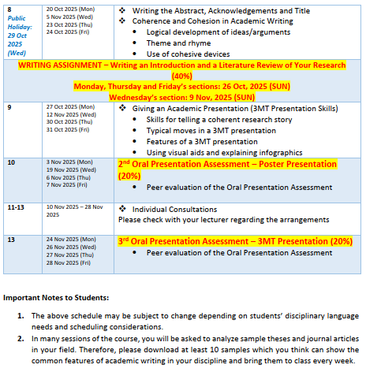
Course Schedule

Slide 7
Introduction to the Course
Type of Assessment | Weighting | CILOs to be Addressed | Description of Assessment Task
Oral Presentation 1: Presentation on a research article | 20% | 1&3 | Students will give an 8-minute presentation on a journal article in their field to a non-specialist audience and explain how the research is relevant to their own study. They should explain the (1) main research objectives, (2) key findings and the significance of the research, and (3) elucidate how the research presented in the journal article may impact their own research design.
Oral Presentation 2: Poster Presentation | 20% | 1 & 3 | This poster presentation assessment requires students to showcase their research focus, research design, and preliminary findings. Students will be assessed on their ability to design a poster showcasing their research, communicate research ideas effectively, engage with peers in thoughtful discussions, and respond to audience questions in a clear and structured manner.
Writing a research paper introduction and a literature review | 40% | 2, 3 & 4 | Students will complete a take-home assignment that includes sufficient background information to provide context and significance for the research, a review of recent and relevant literature, proper acknowledgment of previous work on the topic, and an analysis or reference to the research gap that needs to be filled. Additionally, the assignment should feature a purpose statement highlighting the novelty and contributions of the research.
Oral Presentation 3: Presentation on the student’s own research (3MT Presentation) | 20% | 1 & 3 | Students will give a 3-minute presentation on their own research. They need to explain the objectives, design and significance of their research concisely and powerfully to a non-specialist audience using a range of 3MT features.
Assessment Methods:
Students must complete all course assessments, which in total have to reach at least the satisfactory level in order to pass the course. Please refer to the assessment rubrics for details of the assessment criteria and assessment standards.

Slide 8
Late Submission Policy
Late submissions of assignments will incur penalties – one percent of the final score for that assignment will be deducted for each day past the deadline (weekends and statutory holidays included). Assignments submitted more than 5 days after the deadline will receive a zero mark. If you have a valid reason for late submission, you should discuss it with your lecturer prior to the assignment due date.

Slide 9
Plagiarism Policy
Plagiarism (i.e. copying from other sources without an acknowledgement or copying other students’ work) is not tolerated at HKBU. Should a case of plagiarism be established, University regulations will be strictly applied, and these potentially include failing a course or being expelled from the University. Please read the University’s guidelines for students on academic Integrity.

Slide 10
Use of AI Tools in Assessments
While the University encourages the ethical use of AI for learning (e.g. for brainstorming ideas, exploring information), submitting the output of generative AI tools as your own work in any assignment is deemed a violation of the University’s academic integrity guidelines. Therefore, if AI detection tools indicate that your assignment may consist of any AI-generated text, you will be asked to present a detailed record of your use of generative AI tools in the respective assessment for further investigation. Nonetheless, presenting a detailed record does not necessarily serve as irrefutable evidence that no violation has occurred. The Course Coordinator has the right to make the final decision on whether to apply a penalty and the extent of that penalty.
Please note that any texts submitted to generative AI platforms may be added to the internal databases of such platforms for unknown purposes, potentially infringing on data privacy of the authors of the submitted texts.
You may check whether your writing consists of AI-generated text through the following websites:
GPTZero https://gptzero.me/
Copyleaks https://copyleaks.com/ai-content-detector

Slide 11

Downloading Sample Research Articles
Please download at least 10 research articles in your discipline and bring them to the class.

Slide 12
Warm-up Task
What do you know about the structure of a typical thesis and journal article in your discipline?
Work with a classmate who is also from your discipline, if possible. List the key sections of a typical journal article and key chapters of a thesis in your discipline.
Do you think the thesis and journal article structure are the same for all disciplines? What might be the variations across disciplines? Why?

Slide 13
Structure of a Thesis/Journal Article
A thesis/journal article is a record of research work which usually involves five major stages: (a) identifying a research area, (b) setting research questions which have not yet been sufficiently addressed by previous research, (c) designing a study that will seek to provide answers to the research questions and carrying it out, (d) collecting data, collating, analysing and interpreting results and (e) drawing conclusions or generalizations from your findings. The structure of a thesis and a journal article usually follows the sequence of these five stages:
Introduction
Literature review
Methods
Results
Discussion
Conclusion

Slide 14
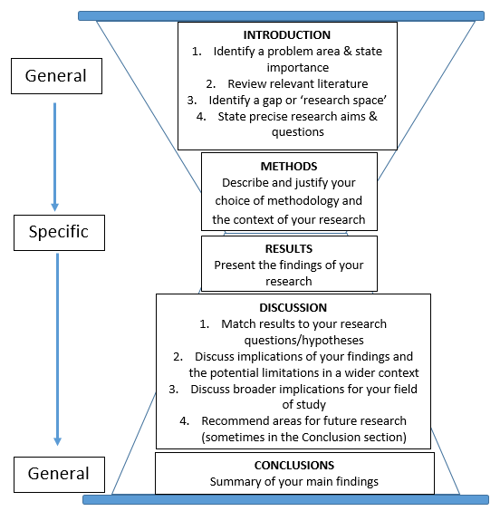
The ‘Hourglass’ Thesis Model Based on Primary Research

Slide 15
Task 1
The structure of a thesis/journal article can vary, depending on the nature of your research. Get into groups of 4 and do the following:
Have you seen other thesis/ journal article structures in addition to the IMRD format?
Other possible structures:
A series of empirical studies (When research involves more than one empirical study such as a series of experiments, surveys, case studies, etc. This structure is common in the science-related disciplines.)
Theme/topic-based theses (In some disciplines in the humanities, research may focus on texts and documents, for example, in literary studies, law, history and philosophy. In social sciences, ethnographic and other types of qualitative studies are most common. The results may be presented according to the themes identified in the source materials.)

Slide 16
Task 2
Research article-based theses (This type of thesis based on published research articles is becoming increasingly common. Each chapter has its own introduction, literature review, methods, results, discussion and conclusion. However, there should still be an introductory chapter at the beginning of the thesis to identify the initial gap in research and link the individual research articles together. Also, the findings from all the papers need to be consolidated in the Conclusion chapter.)
2. Tell your group members the typical thesis/journal article structure in your discipline. Why do you think this structure is particularly common in your discipline?

Slide 17
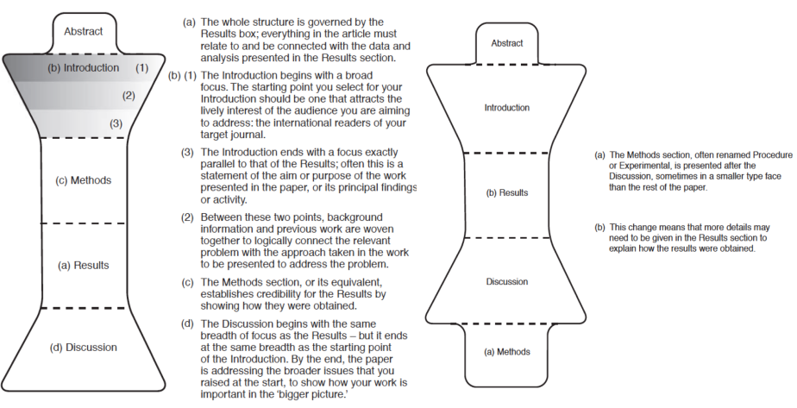
Structure Type 1
Structure Type 2

Slide 18
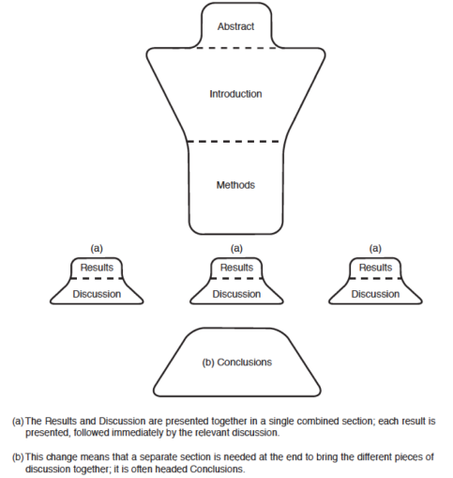
Structure Type 3

Slide 19
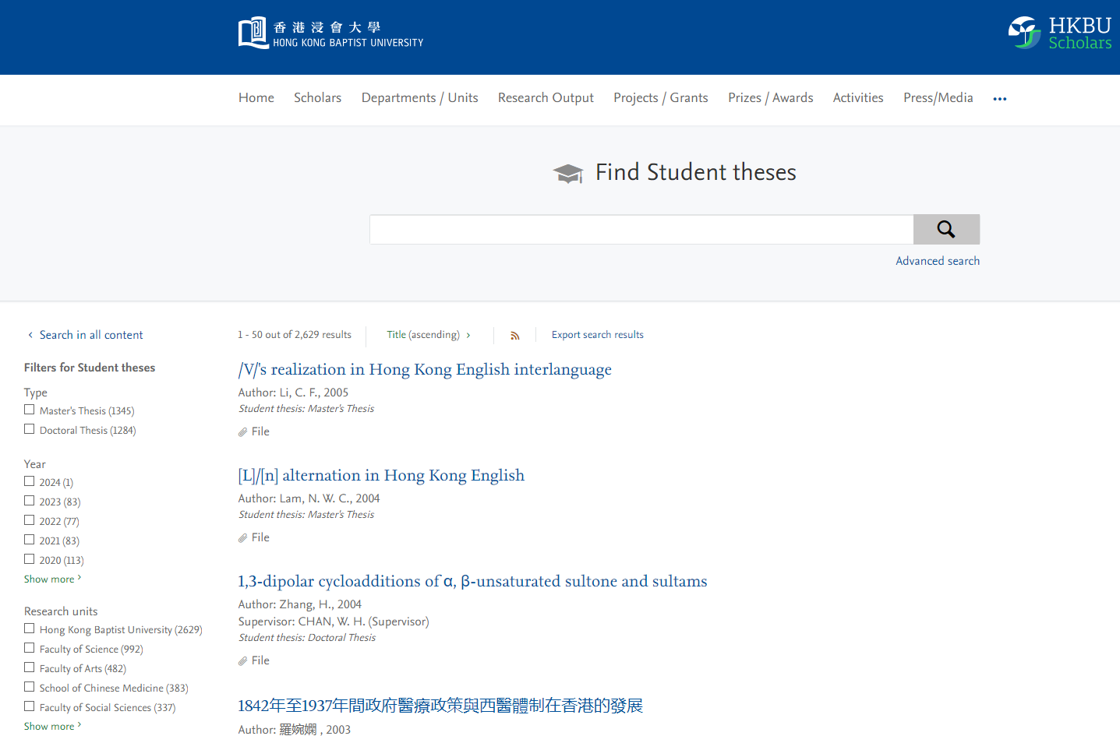
HKBU Postgraduates’ Theses on HKBU Library Website
Students’ Theses on HKBU Library Website: https://scholars.hkbu.edu.hk/en/studentTheses/
Take a look at the former HKBU MPhil and PhD students’ theses to learn about the structure, language features and styles of theses in your discipline.

Slide 20
Introducing Your Research
Introducing your research effectively is a critical skill for any researcher. A well-crafted introduction sets the stage for your work, helping your audience understand the significance of your study, how it fits into existing knowledge, and why it matters. Whether you are writing the introduction section of a manuscript or presenting your research verbally, a clear and compelling introduction engages your audience and establishes your credibility. To make your introduction effective, it is important to provide context, articulate your research problem clearly, and highlight the contribution your work makes to your field. Mastering this skill not only strengthens your communication but also ensures your research makes a lasting impact.

Slide 21
Task 2 – Functions, Key Component and Language Features of an ‘INTRODUCTION’
This task aims to check your prior knowledge about writing an effective introduction of a thesis/journal article in your discipline. Get a partner and discuss the ‘functions’, ‘key components’, ‘structure’ and the ‘language features’ of the introduction of a thesis/journal article in your discipline. Put your ideas in the space provided in the table below.
If your partner is from a different discipline, find out the possible variations across disciplines.

Slide 22
Task 2
 | The ‘Introduction’ of a THESIS / JOURNAL ARTICLE
Functions
Key Components and Structure
Language Features (e.g. tenses, voices, use of technical terms or keywords)
draw your readers in (introduces the topic)
provide background information (briefly mentions some key previous studies)
convince readers that your work is worth reading (highlight the potential contributions of your work)
give direction to the remainder of the thesis/journal article (give an outline)
Identify a research area
Review current knowledge on the topic
Point out the gap in current knowledge on that topic
Explain what you hope to do to fill the gap
The present tense and present perfect tense are predominately used.
The active voice is usually used to present information directly.
Technical terms and keywords are commonly found because the intended readers are usually experts in the field.

Slide 23
Task 2
Questions for further discussion:
What are the possible disciplinary variations in the content (e.g. the key components), structure (e.g. length, number of moves), and language features (e.g. tenses, active vs passive voice, use of technical jargon) of the introduction of a thesis/journal article?
Are there any possible differences between the introduction of a thesis and of a journal article in your own discipline?
Length: shorter (journal article) vs longer (thesis)
Level of detail: More concise (journal article: only include information that is absolutely required to understand the gap in research that led to the study) vs more detailed (thesis: demonstrate familiarity with existing literature and develop background more extensively).
Inclusion of an outline: An outline of the paper may not be included (journal article) vs there must be an outline of the thesis (thesis)

Slide 24
INTRODUCTION of a Thesis/Journal Article
24
A good INTRODUCTION should lead the reader from a general research issue or problem to your specific area of research. It puts your research question in context by explaining the significance of the research being conducted. It should also lay out a roadmap for the rest of the thesis/journal article. The main purposes of an introduction are to:
draw your readers in (introduces the topic)
provide background information (briefly mentions some key previous studies)
convince readers that your work is worth reading (highlight the potential contributions of your work)
give direction to the remainder of the thesis/journal article (give an outline)

Slide 25
INTRODUCTION of a Thesis/Journal Article
The Creating a Research Space (CARS) model, which highlights the key rhetorical moves (organizational patterns) in the introduction of a research paper/thesis, was developed by John Swales (1990) based on his analysis of journal articles representing a variety of discipline-based writing. In this model, there are three main moves:
If you would like to know more about the CARS model, you may read:
Swales, J.M. (1990). Genre analysis: English in academic and research settings. New York: Cambridge University Press
Rhetorical Moves | Writing Actions
Move 1: Establishing a Territory [the situation] | Describe the research problem and provide evidence to support why the topic is important to study. Explain the current state of knowledge, consensus, practice or description of phenomena. Synthesise the key prior research that further supports the need to study the research problem; this is different from a literature review in a way that only the key previous studies which have touched upon but not fully addressed the topic are included.
Move 2: Establishing a Niche [the problem] | Introduce an opposing viewpoint/perspective to the current state of knowledge; or Develop the research problem around a gap/an understudied area of the literature; or Present key questions about the consequences of gaps in prior research that will be addressed by your study; or Extend prior research to expand upon or clarify a research problem.
Move 3: Occupying the Niche [the solution] | Explain clearly the objectives of your study. Present a brief summary of the key findings of your study. Indicate how the remainder of the paper is organized.

Slide 26
Claiming Centrality of Your Research Topic
Research articles and thesis introductions always begin with centrality statements because they help ‘establish the general territory’ [Move 1 in the CARS model] of the research topic. A centrality statement basically makes a general claim that your research topic area is of central interest or importance in the field, or sometimes in the world at large. These claims have four main features:
Characterised by the use of evaluative adjectives e.g. valuable, central, major, important
Referring to the impacts and a growing awareness of a problem e.g. increasingly, growing, a classic problem
Showing the currency of the topic e.g. current, recent, recently
Using an inversion pattern e.g. Particularly noteworthy/significant is that…, Of great/common concern is that…
Stated in present/present perfect tense
Some examples of centrality statements:
Recently, there has been a wide interest in…
The study of…has become an important aspect of…
The relationship between…has been studied by many researchers in the field.

Slide 27
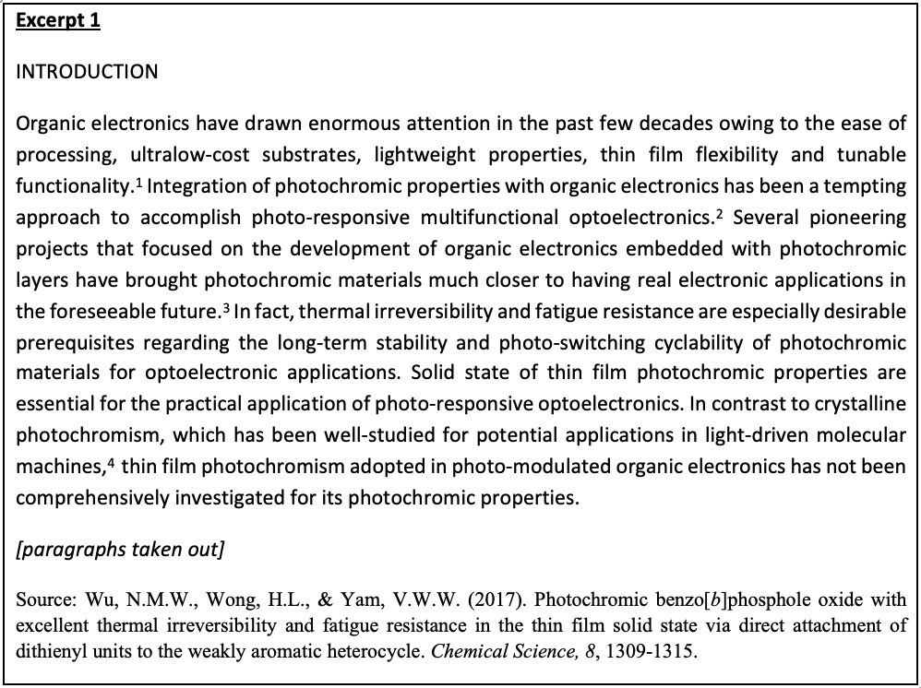
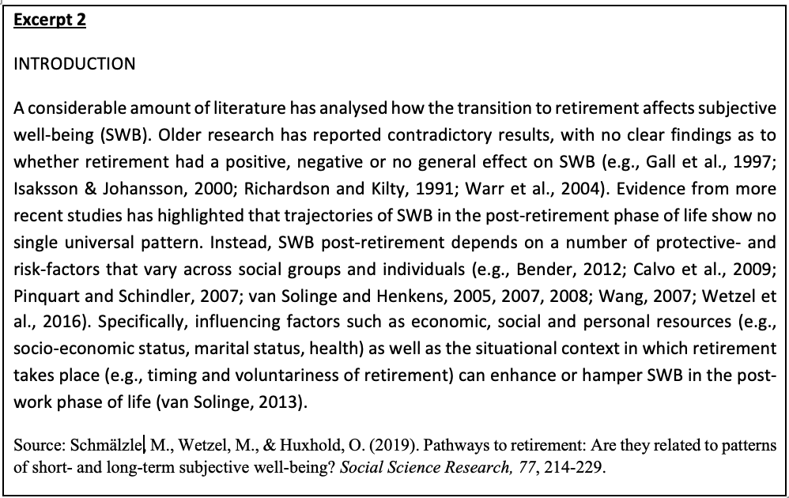
Task 3
Read the two excerpts below which are extracted from the introductions of two academic journal articles (in the fields of Chemistry and Social Sciences). Discuss the following questions with a partner:
27
1. Can you identify the centrality statements in the excerpts? How did the authors establish the general territory of the research topic?

Slide 28
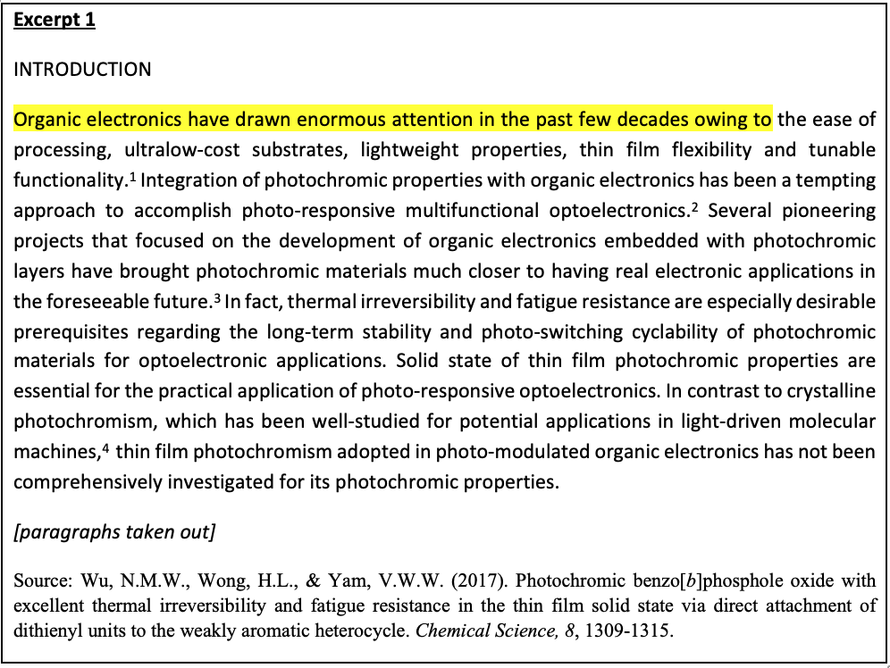
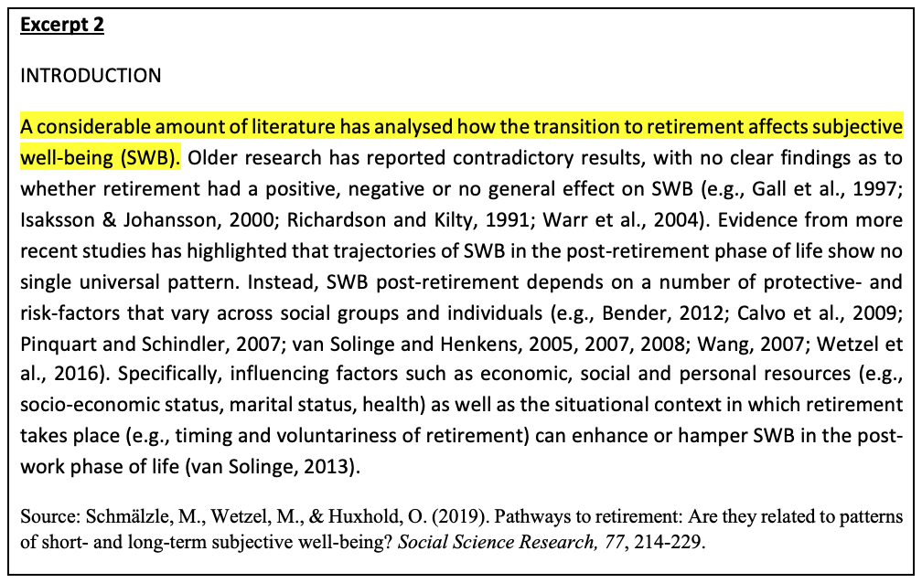
Task 3
28

Slide 29
Task 3
29
In excerpt 1, the author first explained why the topic of organic electronics is becoming more important, and highlighted the achievements made in recent research on using photochromic materials in real electronic applications. Then, the author pointed out that thin film photochromism adopted in photo-modulated organic electronics has not been comprehensively investigated for its photochromic properties. Therefore, more research on this specific area is needed.
In excerpt 2, the author first explained that the topic has received much attention in the literature. Then, s/he pointed out that there have been contradictory results in the older research and the recent research findings do not show any universal pattern in the trajectories of subjective well-being (SWB) in the post-retirement phase of life. S/he further explained that many factors and the situational context in which retirement takes place will affect subjective well-being in post-retirement life. This serves as a lead-in for move 2 which establishes a niche (the gap in the literature which needs further research).

Slide 30
Task 3
2. Can you come up with one or two centrality statements for your own thesis topic? You can use the academic phrasebank (http://www.phrasebank.manchester.ac.uk/introducing-work/) and ChatGPT to help you. After you finish, show your centrality statements to a partner and get comments.

Slide 31

Task 3
3. Ask ChatGPT for some comments on your centrality statements. You may input prompts such as:
“My research is about… (your research focus). I am writing centrality statements to highlight the importance of the research topic in the field of … (your research field). Can you suggest how the following centrality statements can be improved?”
“What are some common phrases and language features used in centrality statements?”
Note: Although ChatGPT is a useful tool, it may not always give you reliable and accurate information. You need to use your own critical judgement to evaluate ChatGPT’s responses. Additionally, you should not ask ChatGPT to write your centrality statements because you understand the importance and novelty of your research topic much better than ChatGPT does.

Slide 32
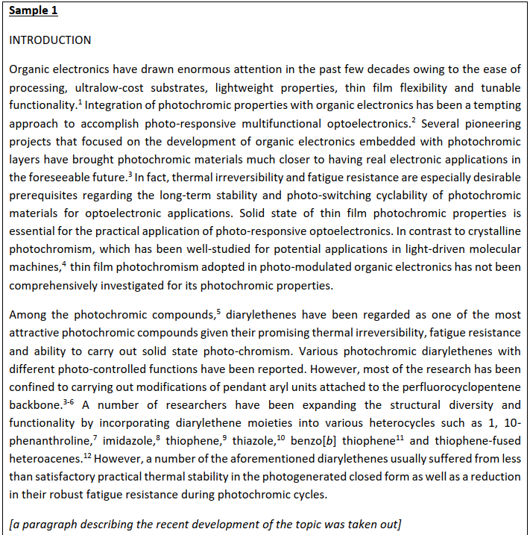
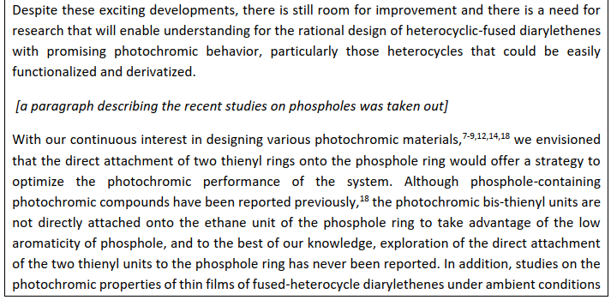
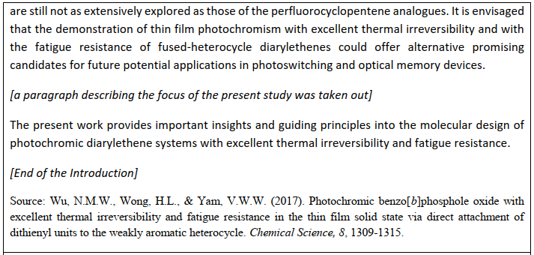
Task 4
Read the two sample introductions extracted from two journal articles in the fields of Chemistry and Social Sciences respectively. Identify the rhetorical moves and the linguistic features.

Slide 33

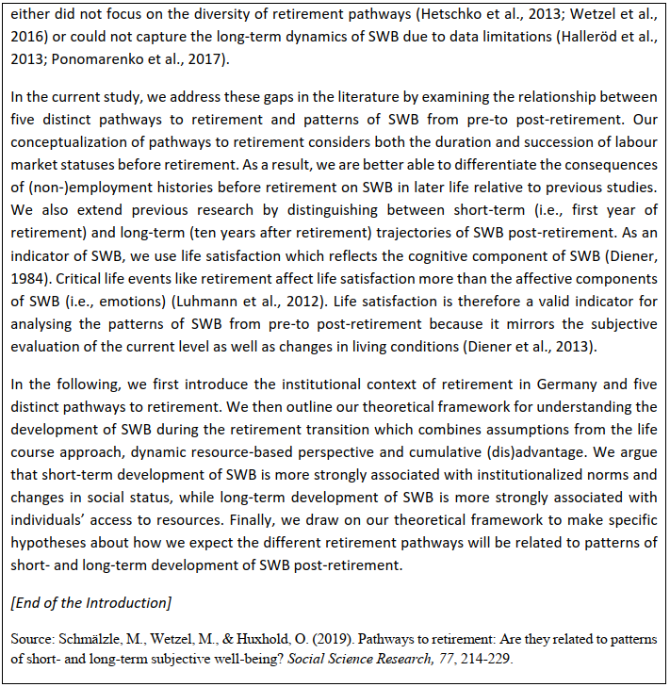

Slide 34
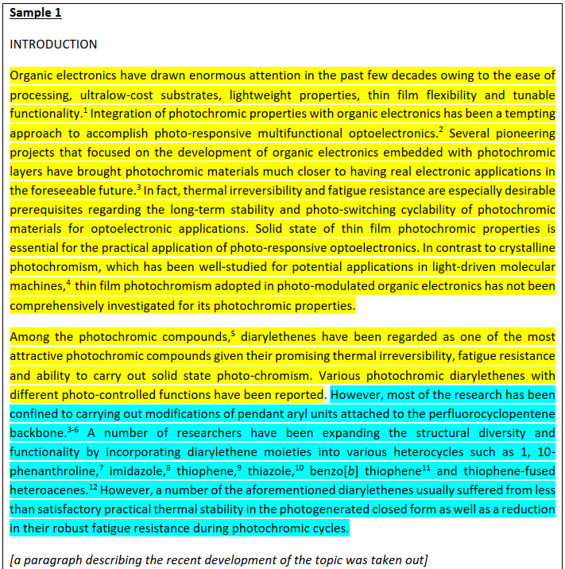
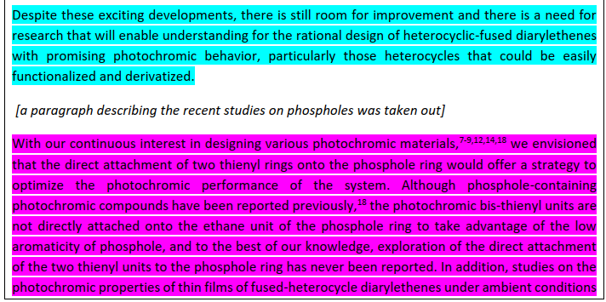
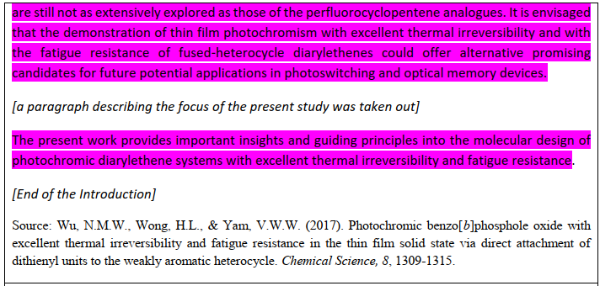
Task 4
34

Slide 35
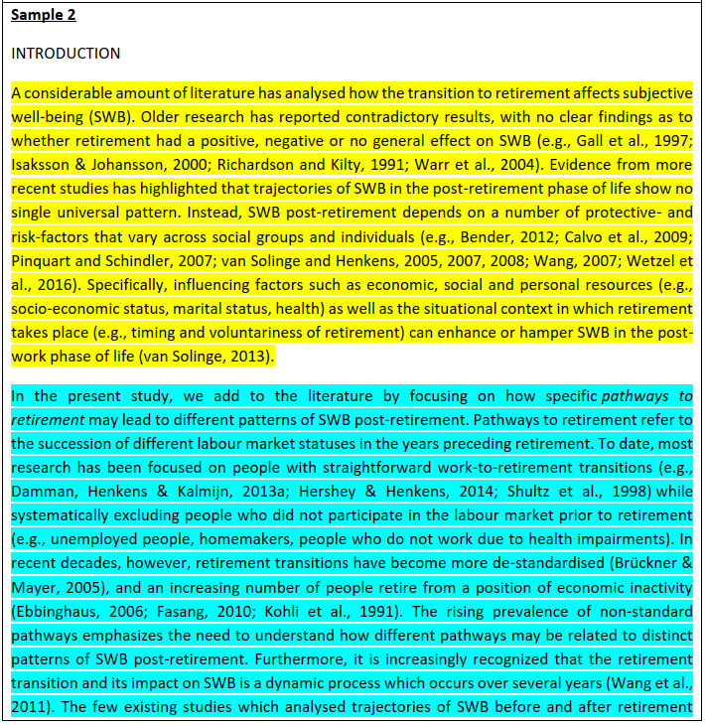
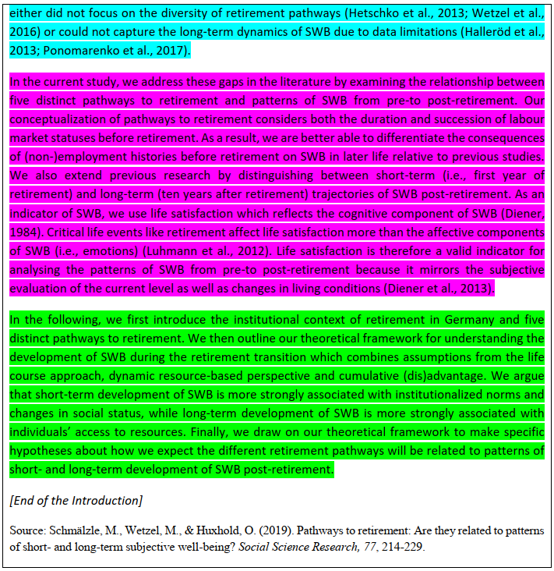

Slide 36
Task 4
36
1. Can you identify the rhetorical moves in the introductions? Are the moves similar or different in the two introductions?
Sample 1:
Move 1 – Explain the importance of the research topic; synthesize the key research studies and highlight the achievements in the previous studies. (Highlighted in yellow in the sample below)
Move 2 – Point out the limitations of the previous studies and the gaps in the literature. (Highlighted in blue in the sample below)
Move 3 – Explain how the current study can address the gaps and to highlight the potential contributions of the study. (Highlighted in purple in the sample below)

Slide 37
Task 4
Sample 2:
Move 1 – Summarise the key findings of the previous research and highlight that there have been contradictory results because many influencing factors may enhance or hamper SWB.
Move 2 – Delineate the research gaps and briefly explain how the current study attempts to address the research gaps.
Move 3 – Further explain how the current study is different from the previous studies and how it could better address the research gaps by using life satisfaction as an indicator which reflects the cognitive component of SWB.
Move 4 – Provide an outline for the whole research paper.
2. To what extent are the moves in the two introductions similar to the CARS model proposed by Swales (1990)?
The moves in the two introductions are largely similar to the CARS model proposed by Swales (1990).

Slide 38
Task 4
38
3. What do you notice about the linguistic features (e.g. tenses, voices, technical jargon) of the introductions?
Sample 1:
Tenses – The present perfect tense is used to refer to the previous research studies; the present tense is used to give background information about the topic and to refer to the contributions of the current study.
Voices – Mostly active voice but the passive voice is also used in some instances when the doers are unknown or unimportant (e.g. In contrast to crystalline photochromism, which has been well-studied for potential applications…; Among the photochromic compounds,⁵ diarylethenes have been regarded as one of the most attractive photochromic compounds…; Various photochromic diarylethenes with different photo-controlled functions have been reported)
Technical jargon – A lot of technical jargon is used probably because the target readers of the articles are specialists in the field.

Slide 39
Task 4
Sample 2:
Tenses - The present perfect tense is used to refer to the previous research studies; the present tense is used to give background information about the topic, to explain the focus and the contributions of the current study, and to give an outline of the paper; the past tense is used to refer to actions in the past.
Voices – The active voice is used.
Technical jargon – There are limited technical terms in the article probably because the topic itself is easily understandable to the non-specialists.

Slide 40
Task 4
40
4. What are the phrases used for pointing out the gaps in the existing literature?
Sample 1: …thin film photochromism adopted in photo-modulated organic electronics has not been comprehensively investigated for its photochromic properties. However, most of the research has been confined to carrying out modifications of pendant aryl units attached to the perfluoro cyclopentene backbone.³ Despite these exciting developments, there is still room for improvement and there is a need for research that will enable understanding for… | Sample 2: Older research has reported contradictory results, with no clear findings as to whether… Evidence from more recent studies has highlighted that trajectories of SWB in the post-retirement phase of life show no single universal pattern. In the present study, we add to the literature by focusing on… To date, most research has been focused on… while systematically excluding people who did not participate in… The rising prevalence of … emphasizes the need to understand… The few existing studies which analysed… did not focus on…or could not capture the long-term…due to data limitations.

Slide 41
Task 4
41
5. What are the phrases used for highlighting the significance of the research?
Sample 1:
With our continuous interest in …, we envisioned that…
The present work provides important insights and guiding principles into…
Sample 2:
In the current study, we address these gaps in the literature by examining the relationship between…
As a result, we are better able to differentiate the consequences of…

Slide 42
Task 5
Part I: Select a journal article in your discipline that you have read recently. Review the introduction section of the article and identify the moves for writing up the Introduction. Pay attention to the language features and the phrases for achieving the moves as well. Share your findings with a partner. Then, report your findings to the class.
Part II: Ask ChatGPT to analyse the structure and the language features of the introduction section of the article you have just analysed. Compare its analysis results with yours. What specific features about the structure and language do you notice? Do you think these features are common in your discipline?
Extended Task (Homework): Select a thesis in your discipline. You can visit HKBU Institutional Repository https://scholars.hkbu.edu.hk/en/studentTheses/to look for a thesis in your field. Review the introduction section of the article and identify the moves for writing up the Introduction and analyse the language features.

Slide 43
Task 6
Planning for the Introduction of Your Research
Now think about the introduction of your own research. Use the space below to make notes. After that, present your ideas to a classmate and explain why you have such a plan.
What are the key components in the introduction of your own research?
What is the organisation pattern of the introduction? What are the moves? Why do you organize the ideas in this way?

Slide 44
Task 7
Introducing Your Research Verbally
Postgraduate students have many opportunities to introduce their research verbally to specialist or non-specialist audiences in different contexts e.g. academic conferences, candidature confirmation seminars, oral defenses (viva), departmental seminars, round-table discussions, lab meetings with thesis supervisors and fellow research postgraduate students, 3-minute thesis competitions. Therefore, it is important for you to be able to verbally introduce your research to others in a concise and organised way.
When introducing your research to others, you need to consider the audience (Is s/he a specialist or non-specialist in your field? What does s/he want to know about your research?), purpose (Is the purpose of the speech to inform/persuade/inspire?), and the structure (How many sections are there? How can you help the audience follow the logical flow of ideas more easily?) of your speech.

Slide 45
At the end of this course, you will be required to introduce your research to your fellow classmates in 3 minutes (Oral Presentation Assessment 3). Now, practice introducing your research to a classmate who may or may not be a specialist in your field.
Use the following guiding questions to help you prepare a two-minute speech introducing your research:
1. What is the general field of your research?
2. What is the particular topic within this field that you are interested in?
3. What specific problems or questions are you interested in?
4. Why are these questions/problems important?
5. What is already known about this topic? What is less known?
6. How will you find out more about this topic?
7. What methods of investigation will you use?
8. What are the expected outcomes?
9. What would be the contributions of your research?
Give some feedback to your classmates by commenting on whether the focus of the research is clear to you and whether you think the speech is organised.
You can find some award-winning three-minute thesis presentations on this website: https://threeminutethesis.uq.edu.au/watch-3mt
45

Slide 46
Task 8
46
Doing Things with Nouns (Nominalization)
Nominalization refers to the process of turning a word of another part of speech (usually an adjective or a verb) into a noun. To nominalize a word such as an adjective means to convert it into a noun (e.g. changing popular into popularity). A nominalized word (e.g. failure) is also called a nominalization.
Nominalization is an integral feature of written language and has a few advantages for writers. Nominalization:
enables the writer to write concisely because it allows information to be packed into a noun-phrase, so that the rest of the clause is available for adding new information. (e.g. His dedication to the job is known to all his colleagues.)
provides a link between parts of a text. (e.g. He behaved badly in class and was sent to detention. He was reprimanded by the discipline master and felt sorry for his misbehavior.)
enables us to categorize, label and describe phenomena. (e.g. urbanization, environmental pollution and Internet addiction)

Slide 47
For the above reasons, it is important for advanced learners of English to learn to nominalize or use nominalizations appropriately in academic writing. (However, it is also important not to overuse nominalizations.)
In order to be able to nominalize a word, you need to be able to turn a word into a noun. Can you turn the following adjectives/verbs into nouns?
Adjectives/Verbs
available
familiar
necessary
suitable
wise
announce
develop
resign
survive
terminate
likely
possible
probable
tend
Nouns
availability
familiarity
necessity
suitability
wisdom
announcement
development
resignation
survival
termination
likelihood
possibility
probability
tendency

Slide 48
48
Rewrite the following sentences by nominalizing the underlined words.
1. The government should make more affordable housing available to low-income families.
2. The campaign is aimed at making the public more aware of the dangers of drug abuse.
3. A fall in unemployment will make consumers confident again.
The government should increase the availability of affordable housing to low-income families.
The campaign is aimed at raising public awareness of the dangers of drug abuse
A fall in unemployment will restore consumer confidence.

Slide 49
4. Size of pension depends partly on how long the employee has served the company.
5. The Internet has become more and more popular.
6. If you are heavily reliant on one client when you are building up your business, it is risky.
Size of pension depends partly on length of service with the company.
The popularity of the Internet has soared.
Heavy reliance on one client is risky when you are building up a business.

Slide 50
Now, refer to a journal article from your discipline and identify three sentences that use nominalization. Analyze the sentence structure and examine how nominalization enhances the conciseness and clarity of the sentences.
Sentence 1: Sentence 2: Sentence 3:

Slide 51
Speaking Practice Task:
Features of a Good Thesis/Journal Article
What do you think are the most important features of a good thesis/journal article? Give a 1-minute speech on this topic. Your teacher may ask you to give the speech in front of the class.
Content | Language | Organisation
careful substantiation of the argument good use of sources clear referencing clearly defined research niche (novelty) clear development of topic clearly defined research contributions | well-structured sentences correct spelling simple vs complex word choices and grammatical sentences academic word choice | clearly structured argument good cohesion between paragraphs/sections good cohesion within paragraphs logical transition between chapters clear layout clear overall organization

Slide 52
Independent Language Learning:
As a postgraduate student, you need to be able to enhance your academic reading, writing, speaking, listening and research skills independently. To do this systematically, it would be useful if you i) set language learning goals for yourself (i.e. identify one or two language areas that you would like to improve), ii) select relevant learning materials and methods from the Independent Language Learning Guide (available on Moodle), iii) carry out the independent language learning activities, and iv) regularly monitor and reflect on your own learning progress. In this course, there will be an individual consultation in which you can discuss your language learning plans and/or the problems you encountered in the independent language learning process with your lecturer. The Language Centre is also providing a range of language learning support services to HKBU students. Please ask your lecturer for more details.

Slide 53
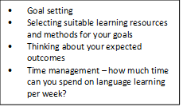
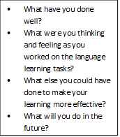
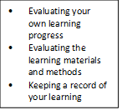
An effective independent language learner should be able to plan, monitor and reflect on their own learning
Planning
Monitoring
Reflecting

Slide 54
Now, start to create a plan to help yourself enhance your English skills during your postgraduate studies. Please refer to Sections 3 and 5 of the Independent Language Learning Guide in order to complete your goals plan.

Slide 55
Online Resources:
1. Using Online Corpora to Search for Specific Language Examples:
BNCweb: http://bncweb.lancs.ac.uk/bncwebSignup/user/login.php
AntConc: https://www.laurenceanthony.net/software/antconc/
British Academic Written English (BAWE) corpus: https://app.sketchengine.eu/#dashboard?corpname=preloaded%2Fbawe2
Corpus of Contemporary American English (COCA): https://www.english-corpora.org/coca/

Slide 56
Homework Tasks for Session 1:
Put your independent language learning goal in the Shared Doc. created by your lecturer
Watch the short videos about BNCWeb and AntConc corpora and build your own corpus
Collect at least 10 research articles related to your own research topic

Slide 57
Build Your Personal Corpus
What is a corpus?
a corpus (plural corpora) or text corpus is a language resource consisting of a large and structured set of texts (nowadays usually electronically stored and processed). In corpus linguistics, they are used to do statistical analysis and hypothesis testing, checking occurrences or validating linguistic rules within a specific language territory. It is a useful tool for students to improve their writing and vocabulary.
In this course, you will know how to use two corpora (plural form of corpus):
BNCWeb Corpus: http://bncweb.lancs.ac.uk/bncwebSignup/user/login.php
AntConc: https://www.laurenceanthony.net/software/antconc/

Slide 58
Introductory Videos on Corpora
Homework for this week:
Register for an account
Customise the user’s settings
BNC Web Corpus:
1. Login and Create an Academic Subcorpus in the BNCWeb (~ 6 mins)
https://youtu.be/rqs7xK-sU7M
2. Customise User’s Settings (~ 4 mins)
https://youtu.be/sa8szUGPNvg

Slide 59
Introductory Videos on Corpora
Homework for this week:
Download the software on your device
Build your own corpus by importing the research articles you have collected
AntConc:
1. Create Your Own Corpus with AntFileConverter (~ 6 mins)
https://youtu.be/UJ5agGJS_iY
2. Introduction to AntConc + File View Function (~6 mins)
https://youtu.be/-o1i09GF5Y8

